Slide 1
Ethical Considerations in Geographic Information Systems (GIS)
Exploring the Ethical Dimensions of GIS Practices
Joshua Farrell
Colorado State University Global
CSC502: Ethical Leadership in Software Development
Dr. Shaher Daoud
Sept 9, 2025

Slide 2
Agenda
1. Introduction
2. The Common Good vs. Privacy Risks
3. GIS and Individual Rights
4. The Dangers of GIS Data Abuse
5. Historical Parallel – Surveillance and GIS Misuse
6. Should GIS Data Be Restricted?
7. Ethical Solutions for GIS
8. Privacy Regulations and Standards
9. Future Trends in Ethical GIS
10. Conclusion

Slide 3
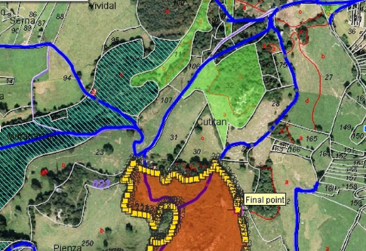
Introduction
Understanding Geographic Information Systems (GIS) GIS supports various applications including mapping and navigation.
Key Ethical Concerns in GIS Privacy, data security, and accessibility are critical ethical issues.
Exploring the Dilemmas The presentation will examine ethical dilemmas and propose potential solutions.
Figure 1
GIS Services
[use this space to place an image that best captures the main idea of point #1]
Note: Adapted from GIS Services, by Discovery GEO Consultancy, 2020, Discovery GEO Consultancy. https://discoverygeoconsultancy.com/services-geo.html.
Notes:
In this slide, we'll discuss the fundamental concepts surrounding GIS and its ethical ramifications. We'll highlight some key ethical concerns that professionals encounter in the field, particularly in regards to privacy, data security, and accessibility, setting the stage for deeper exploration later in the presentation.

Slide 4
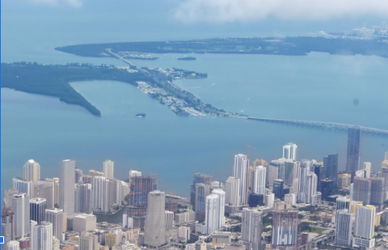
The Common Good vs. Privacy Risks
Benefits of GIS Improves urban planning by analyzing spatial data.
Enhances Public Safety Facilitates efficient disaster response through real-time data.
Privacy Concerns Widespread access to data may lead to privacy violations.
Figure 2
Miami City Aerial View
[use this space to place an image that best captures the main idea of point #2]
Note. Adapted from Miami City Downtown Aerial View, by Bigstock, n.d., Carpe Travel. https://carpe-travel.com/miami-travel-guide/. Used for commercial and non-commercial purposes.
Notes:
In this slide, we will explore the dual aspects of GIS utilization: its benefits for public services like urban planning and disaster response, alongside the privacy concerns that arise from data access. It's important to find a balance between leveraging data for the common good and safeguarding individual privacy rights.

Slide 5

GIS and Individual Rights
Privacy Concerns with Location Tracking Location tracking in GIS can infringe on personal privacy, raising significant issues.
User Control Over Data Many users are unaware and lack control over their data’s collection and distribution.
Importance of User Consent Ethical GIS practices must include mechanisms for obtaining user consent and ensuring data transparency.
Figure 3
Mass Surveillance Concept
[use this space to place an image that best captures the main idea of point #1]
Note. Adapted from HEADER-empoyeeretention-1024x683, by INAA, n.d., INAA Organization. https://www.inaa.org/how-to-improve-employee-retention-rate-in-accountancy-through-company-culture/. Used for commercial and non-commercial purposes.
Notes:
In this slide, we will explore the intersection of GIS technology and individual rights, particularly focusing on privacy issues related to location tracking and data management. It's crucial for users to understand their rights regarding data use, and for GIS developers to prioritize ethical considerations in their systems. We'll also examine the importance of user consent and transparency in data practices.

Slide 6
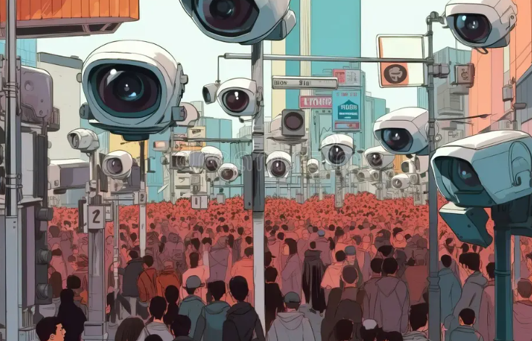
The Dangers of GIS Data Abuse
Mass Surveillance by Governments and Corporations GIS technology can enable extensive monitoring of populations.
Cybersecurity Risks GIS databases can be targets for hacking and data breaches.
Commercial Misuse of Data Companies may sell sensitive location data without user consent.
Figure 4
Mass Surveillance Concept
[use this space to place an image that best captures the main idea of point #2]
Note. Adapted from Mass surveillance concept, multiple security cameras observing crowded city street from above, by Dreamstime, n.d., Dreamstime Stock Images. https://www.dreamstime.com/mass-surveillance-concept-multiple-security-cameras-observing-crowded-city-street-above-generative-ai-digital-illustration-image282320284. Used for commercial and non-commercial purposes.
Notes:
In this slide, we explore the potential dangers of Geographic Information Systems (GIS) when their data is misused. It is important for us to understand both the ethical implications and the risks associated with GIS data abuse, especially as technology advances rapidly. Let's look at three major concerns: mass surveillance capabilities, cybersecurity vulnerabilities, and commercial misuse of location data.

Slide 7

Historical Parallel – Surveillance and GIS Misuse
Historical Context During WWII, the Nazis misused census data for tracking Jewish populations.
Modern Concerns Current GIS technology can lead to targeting of marginalized communities.
Need for Ethical Frameworks Establishing ethical guidelines is essential to prevent the weaponization of location tracking.
Figure 5
Berlin in Ruins
[use this space to place an image that best captures the main idea of point #1]
Note. Adapted from Roland Fischer, by Normandy 1944 Info, n.d., Normandy 1944 - D-Day & Battle of Normandy. https://www.normandy1944.info/stories/roland-fischer. Used for educational and historical reference.
Notes:
Today, we draw parallels between historical misuse of data during WWII and potential misuses of GIS technology. It’s crucial to understand the ethical implications to prevent similar abuses in modern contexts.

Slide 8

Should GIS Data Be Restricted?
Access to Publicly Funded GIS Data Should be open for research and innovation.
Real-Time Personal Location Data Requires strict access controls to protect privacy.
Regulatory Balance Needed Must balance the need for accessibility with security concerns.
Figure 6
Software Tester Checking Code
[use this space to place an image that best captures the main idea of point #2]
Note. Adapted from Indian Software Tester Checking Code, by Depositphotos, n.d., Depositphotos. https://depositphotos.com/photos/software-testing.html. Used for educational and illustrative purposes.
Notes:
In this slide, we discuss the tension between accessibility and privacy concerning GIS data. It's essential to recognize the benefits of open data for research, yet we must also consider the implications of sensitive information. Finding the right balance is crucial for fostering innovation while protecting individuals' rights.

Slide 9
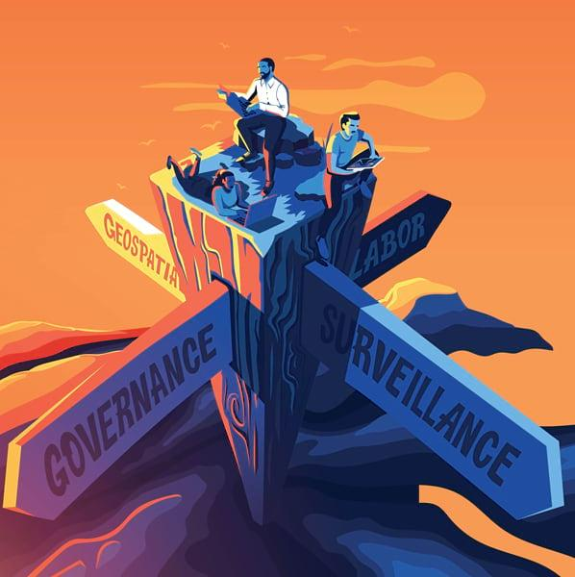
Ethical Solutions for GIS
Data Access and Security Implement strict data access policies and encryption to protect sensitive geographical information.
Informed Consent Ensure individuals provide informed consent before their location data is collected.
Oversight and Regulation Establish independent oversight committees to govern GIS ethics and practice.
Figure 7
Geoethics in the Geospatial Community
[use this space to place an image that best captures the main idea of point #1]
Note. Adapted from Geoethics in the Geospatial Community, by Esri, n.d., ArcNews. https://www.esri.com/about/newsroom/arcnews/geoethics-in-the-geospatial-community/.
Notes:
This slide outlines three key ethical solutions necessary for the responsible use of Geographic Information Systems. The points highlight the importance of data access policies, informed consent, and the role of oversight committees in maintaining ethical standards.

Slide 10

Privacy Regulations and Standards
Tailored Privacy Regulations Establish privacy regulations specifically designed for GIS applications.
Robust Standards Implementation Implement strong standards to ensure the protection of personal rights.
International Cooperation Encourage global collaboration on ethics related to GIS.
Figure 8
Global Data Privacy Laws
[use this space to place an image that best captures the main idea of point #2]
Note. Adapted from International & U.S. Data Privacy Laws and Regulations You Need to Know, by CDP, n.d., CDP.com. https://cdp.com/basics/international-u-s-data-privacy-laws-and-regulations-you-need-to-know/. Used for educational and illustrative purposes.
Notes:
In today's discussion, we will delve into the critical importance of privacy regulations specific to GIS applications. We will explore how these regulations can protect individual rights and the role of international cooperation in promoting GIS ethics.

Slide 11

Future Trends in Ethical GIS
Emerging Technologies New technologies necessitate the development of updated ethical guidelines.
Public Advocacy There is a rising public interest in privacy rights concerning GIS data.
AI and Ethics Artificial intelligence's impact on data ethics requires careful consideration.
Figure 9
GIS analyst illustration
[use this space to place an image that best captures the main idea of point #1]
Note. Adapted from What Is a GIS Analyst? A Career Overview, by Elmhurst University, n.d., Elmhurst University Blog. https://www.elmhurst.edu/blog/gis-analyst/. Used for educational and illustrative purposes.
Notes:
In this slide, we will explore the future trends in ethical issues concerning GIS. As technology continues to evolve, it is crucial to establish new guidelines that address these changes. The increasing awareness among the public regarding privacy rights will also influence how we manage and share geographic data. Lastly, we need to consider how artificial intelligence and machine learning will shape data ethics moving forward.

Slide 12

Conclusion
Powerful Tool with Ethical Risks GIS can greatly benefit society but poses ethical challenges.
Addressing Privacy Concerns Implementing regulations and ethical design is essential.
Balancing Key Factors Accessibility, security, and privacy must be managed effectively.
Figure 10
Ethics and Virtual Litigation
[use this space to place an image that best captures the main idea of point #2]
Note. Adapted from Ethics and Virtual Litigation: Yes or No?, by Litili Group, n.d., Litili Group. https://litiligroup.com/ethics-and-virtual-litigation-yes-or-no/. Used for educational and illustrative purposes.
Notes:
In conclusion, geographic information systems, while incredibly beneficial, require careful ethical consideration. We must prioritize privacy and design systems that not only comply with regulations but also maintain the trust of the public. Striking the right balance between accessibility, security, and privacy will ensure that GIS serves everyone fairly and ethically.

Slide 13
References
DeLong, K. (2016). Ethical issues in geographic information systems. Geospatial Technologies: Geo-ethics Pioneering Initiative. Retrieved from http://geospatial.nationalacademies.org/ethics.pdf
Sui, D. Z., Elwood, S., & Goodchild, M. F. (2013). Crowdsourcing geographic knowledge: Volunteered geographic information (VGI) in theory and practice. Springer. Retrieved from https://link.springer.com/book/10.1007/978-94-007-4587-2
Roche, S. (2015). Geographic information science and systems: Ethical and social implications. In D. Z. Sui, S. Elwood, & M. F. Goodchild (Eds.), Crowdsourcing geographic knowledge (pp. 205-217). Springer. Retrieved from https://doi.org/10.1007/978-94-007-4587-2_12
Friedewald, M., & Peissl, W. (2017). Surveillance, privacy, and security: Citizens’ perspectives. Science and Public Policy, 44(3), 315-325. https://doi.org/10.1093/scipol/scw071
Hassani, M., & Young, S. D. (2024). An evaluation of the user experience and privacy concerns of individuals misusing opioids using a location tracking mobile application. Substance Use & Misuse, 59(3), 336-342. https://doi.org/10.1080/10826084.2023.2270583

